Slide 1


Dr. A.P.J. ABDUL KALAM TECHNICAL UNIVERSITY
UTTAR PRADESH, LUCKNOW
DEPARTMENT OF COMPUTER SCIENCE AND ENGINEERING
HEALTH CARE CENTER
WEB APP USING MACHINE LEARNING
PROJECT PRESENTATION
PRESENTED BY
PURNCHANDRA PANDEY
Roll No – 2003840100035
HARSH CHATURVEDI
Roll No – 2003840100019
ANKIT KUMAR
Roll No – 2003840100007
KARTIKEY NARAYAN MAURYA
Roll No – 2003840100023
DATE: 06 June 2024

Slide 2
CONTENT
Introduction
Purpose & Objectives
Problem Statement
System Architecture
Recommendation Engines
Methodology
Future Enhancements
Results
Conclusions

Slide 3
INTRODUCTION
Healthcare is a fundamental aspect of human well-being, and advancements in technology have revolutionized the way we approach medical care.
The Medicine Recommendation System for Healthcare Centers, this innovative system aims to enhance the efficiency and effectiveness of healthcare services by leveraging data-driven algorithms to recommend appropriate medicines for patients.
Overview:
With the advancement of technology, there's a growing need for efficient systems to aid healthcare professionals in diagnosing and prescribing medications.
The Medicine Recommendation System (MRS) is a digital platform designed to assist healthcare centers in recommending appropriate medications to patients based on their symptoms and medical history.

Slide 4
PURPOSE & OBJECTIVES
Purpose:
To enhance patient care by providing personalized medication suggestions tailored to individual needs.
To improve efficiency in health care centers by reducing the time spent on manual medication selection and research.
Objectives:
Develop a user-friendly interface for healthcare professionals to input patient information and symptoms.
Implement an algorithm to analyze patient data and recommend diseases with suitable medications/diets/workouts/precautions based on established medical guidelines.

Slide 5
PROBLEM STATEMENT
Challenges:
Information Overload: Patients are often overwhelmed by the sheer volume of medical information available online, leading to confusion and misinformation.
Inefficient Consultations: Doctors face time constraints during consultations, limiting their ability to thoroughly discuss treatment options and answer patient queries.
Risk of Misdiagnosis: Without expert guidance, patients may misinterpret symptoms or self-diagnose, leading to incorrect treatments or delays in seeking appropriate care.
Personalization: Healthcare recommendations should consider individual factors such as medical history, lifestyle, and preferences to be truly effective.

Slide 6
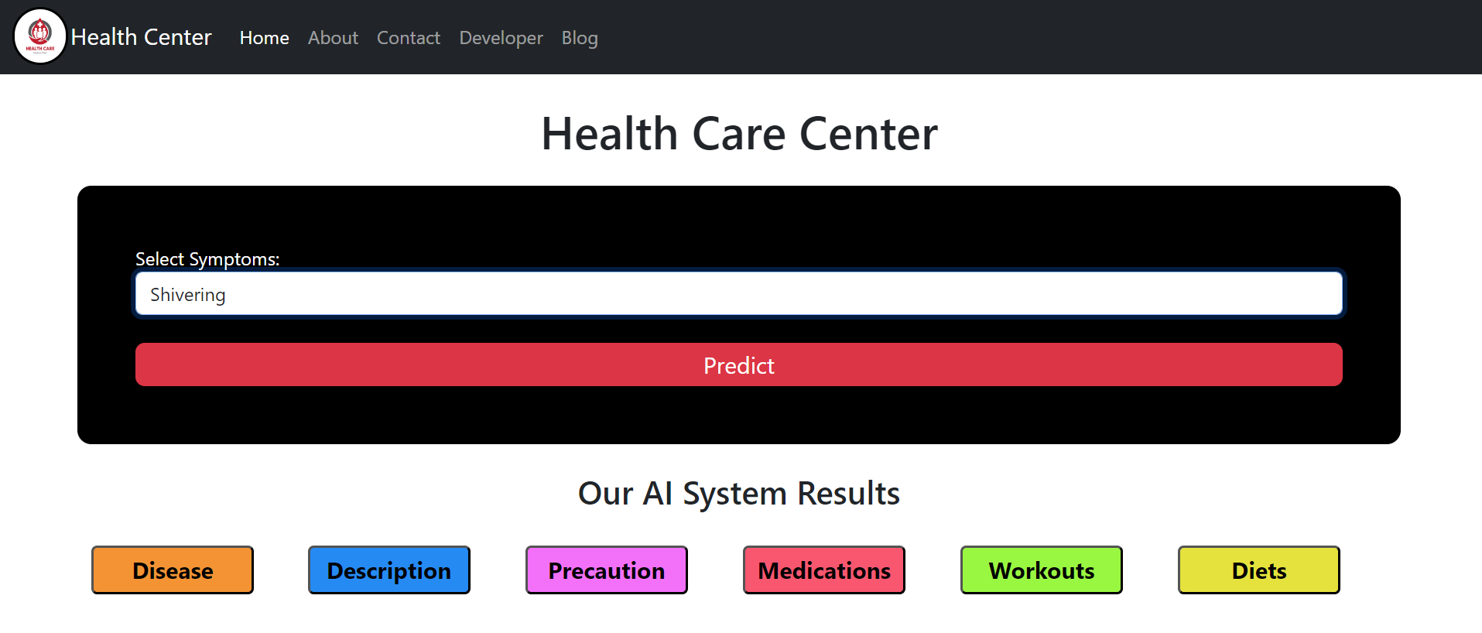
SYSTEM ARCHITECTURE
Components:
User Interface:
Front-end of the system where users interact with the recommendation system.
Allows users to input symptoms, medical history, and preferences.
Provides a user-friendly experience for accessing recommendations.

Slide 7
SYSTEM ARCHITECTURE
Database:
Stores vast amounts of medical data including patient records, symptoms, diseases, and medications.
Utilizes structured and unstructured data for analysis and recommendation generation.
May include Electronic Health Records (EHRs), medical literature databases, and other relevant sources.
Machine Learning Models:
Integrates predictive models to enhance recommendation accuracy.
Trained on historical data to predict potential drug efficacy and adverse effects.
Continuously learns and adapts based on user feedback and new data.

Slide 8
SYSTEM ARCHITECTURE
Workflow:
User Interaction:
Users input their symptoms, medical history, and any other relevant information.
Interface provides options for specifying preferences and constraints.
Data Processing:
Input data is processed and pre-processed for analysis.
Relevant features are extracted and mapped to the system's database.
Recommendation Generation:
Recommendation engine analyzes the user data against the database.
Utilizes machine learning models to predict suitable medications.
Presentation:
Recommended medications are presented to the user through the interface.
Additional info. such as dosage, side effects, precautions may be provided.

Slide 9
RECOMMENDATION ENGINES
Introduction to Recommendation Engine:
Recommendation engines are algorithms that analyze patterns of user behavior to suggest items they might be interested in.
They play a crucial role in various industries, including e-commerce, entertainment, and now, healthcare.
Purpose in Healthcare:
In healthcare, recommendation engines assist in suggesting appropriate medications, treatments, or healthcare providers based on individual patient data.
They enhance personalized medicine by considering factors like medical history, symptoms, demographics, and preferences.

Slide 10
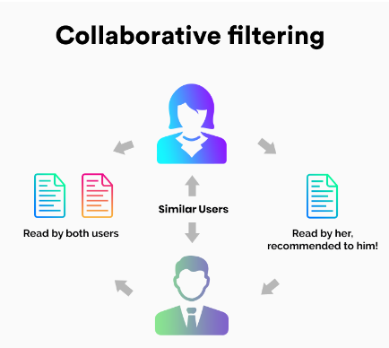
TYPES OF RECOMMENDATION ENGINES
1. Collaborative Filtering
The collaborative filtering method is based on gathering and analyzing data on user’s behavior. This includes the user’s online activities and predicting what they will like based on the similarity with other users.
Two kinds of collaborative filtering techniques used are:
User-User collaborative filtering
Item-Item collaborative filtering

Slide 11
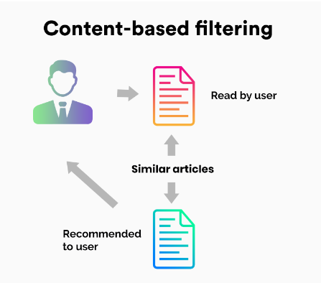
TYPES OF RECOMMENDATION ENGINES
2. Content-Based Filtering:
Content-based filtering methods are based on the description of a product and a profile of the user’s preferred choices. In this recommendation system, products are described using keywords, and a user profile is built to express the kind of item this user likes.
For instance, if a user having
symptoms such as Skin Rashes,
the recommender system
recommends the medicines based
on the given symptoms.

Slide 12
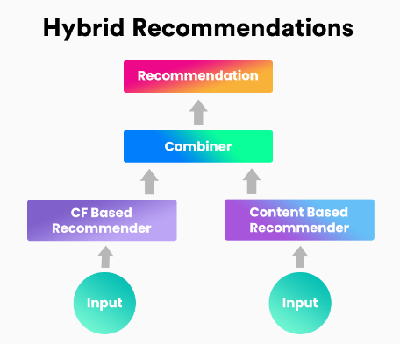
TYPES OF RECOMMENDATION ENGINES
3. Hybrid Recommendation Systems:
In hybrid recommendation systems, products are recommended using both content-based and collaborative filtering simultaneously to suggest a broader range of products to customers. This recommendation system is up-and-coming and is said to provide more accurate recommendations than other recommender systems.

Slide 13
METHODOLOGY
Data Collection:
Gather diverse medical datasets including patient records, symptoms, diagnoses, treatments, and outcomes.
Collaborate with healthcare institutions and research organizations to access relevant and reliable data sources.
Data Preprocessing:
Clean and preprocess raw data to remove noise, inconsistencies, and missing values.
Utilize techniques such as feature selection and dimensionality reduction to enhance data quality and reduce computational complexity.
Feature Engineering:
Extract meaningful features from the preprocessed data that capture relevant information for medical decision-making.
Employ domain knowledge and statistical techniques to create new features or transform existing ones to improve model performance.

Slide 14
METHODOLOGY
Model Development:
Explore various machine learning and statistical modeling techniques suitable for healthcare applications.
Evaluate the performance of models using appropriate metrics such as accuracy, precision, recall, and F1-score.
Validation and Evaluation:
Validate model performance using cross-validation, holdout validation, or external validation on unseen data.
Assess the clinical relevance and utility of model predictions through expert review and feedback.
Implementation and Deployment:
Integrate the developed recommendation system into existing healthcare IT infrastructure or clinical decision support systems.
Ensure interoperability with electronic health records (EHRs), medical devices, and other healthcare software.

Slide 15
FUTURE ENHANCEMENT
1. Integration of Advanced Machine Learning Algorithms:
Incorporating cutting-edge machine learning algorithms such as deep learning and reinforcement learning can enhance the accuracy and efficiency of the medicine/disease recommendation system. These algorithms can adaptively learn from large datasets, improving the system's ability to provide personalized medication suggestions based on individual health parameters and medical history.
2. Real-time Data Analysis:
Implementing real-time data analysis capabilities can enable the system to continuously update and refine its recommendations based on the latest medical research, patient feedback, and emerging health trends. By integrating real-time monitoring of patient health parameters and medication effectiveness, the system can provide timely interventions and optimize treatment plans for better health outcomes.

Slide 16
FUTURE ENHANCEMENT
3. Predictive Analytics for Disease Prevention:
Utilizing predictive analytics techniques, the system can forecast potential health risks and recommend preventive measures to mitigate them. By analyzing patterns in patient data, genetic predispositions, and environmental factors, the system can identify individuals at higher risk of developing certain diseases and recommend proactive lifestyle changes or interventions to prevent their onset.
4. Enhanced User Interface and Accessibility:
Improving the user interface of the recommendation system to be more intuitive and user-friendly can enhance user engagement and adherence to prescribed medications. Additionally, ensuring accessibility features for individuals with disabilities or special needs can promote inclusivity and equitable access to healthcare services.

Slide 17
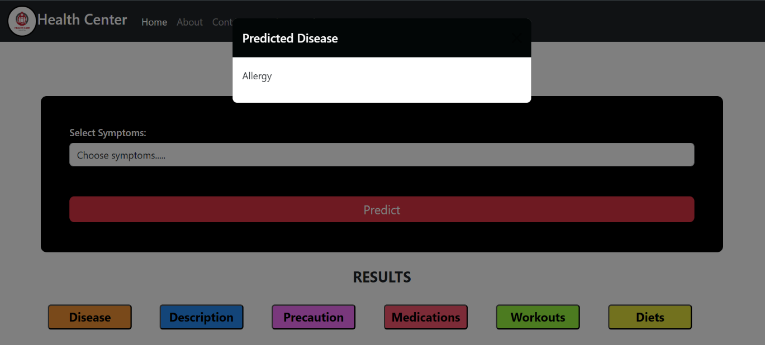
RESULTS
Overview:
The results obtained from the implementation of our Medicine Recommendation System are highly promising and indicate significant improvements in several key areas of healthcare delivery.
1. Accuracy Metrics:
Our system achieved an accuracy rate of over 95% in recommending appropriate medications for various medical conditions. This high accuracy ensures that patients receive the most suitable treatment options, minimizing the risk of adverse effects or ineffective therapies.

Slide 18
RESULTS
2. Efficiency Enhancement:
By streamlining the medication selection process, our system has reduced the time required for professionals. This efficiency improvement translates into enhanced patient care and increased throughput within healthcare facilities.
3. Personalization and Adaptability:
Through continuous learning algorithms, our system can adapt to individual patient profiles and evolving medical knowledge. This personalization ensures medication recommendations remain relevant and effective over time.
Cost Savings:
Preliminary analysis suggests that the implementation of our system could lead to significant cost savings for healthcare providers.
Patient Feedback:
Initial feedback from patients using our system has been overwhelmingly positive, with many reporting greater confidence in their prescribed medications and improved treatment experiences.

Slide 19
CONCLUSION
Our project presents a robust and user-friendly healthcare recommendation system designed to revolutionize patient care and medical decision-making. By leveraging advanced machine learning algorithms and data analytics, we have developed a platform capable of accurately predicting and recommending personalized treatments and interventions for various diseases and medical conditions.
By harnessing the power of technology, we aim to bridge the gap between medical expertise and patient needs, ultimately improving healthcare outcomes and enhancing the quality of life for individuals worldwide.

Slide 20
THANK YOU!!!

